Slide 1


Slide 2
Team Contribution (DevDroid)
Name | Reg No | Batch | Official-email (phone) | Contribution
Ankit Ambasta | 22BCT0041 | 1 | ankit.ambasta2022@vitstudent.ac.in (6395727518) | Front-end(UI - add medicine and analytics window) Back-end(AlarmReceiver , NotificationReceiver , PDF generation,logic for analytics and checkbox, analytics room database )
Atulya Kumar | 22BCT0289 | 2 | atulya.kumar2022@vitstudent.ac.in (8103877504) | Front-end(UI - RecyclerView for item_medicine and item_all_medicine view medicines activity ) Back-end(General Room database - integration , CRUD logic implementation , permission management)

Slide 3
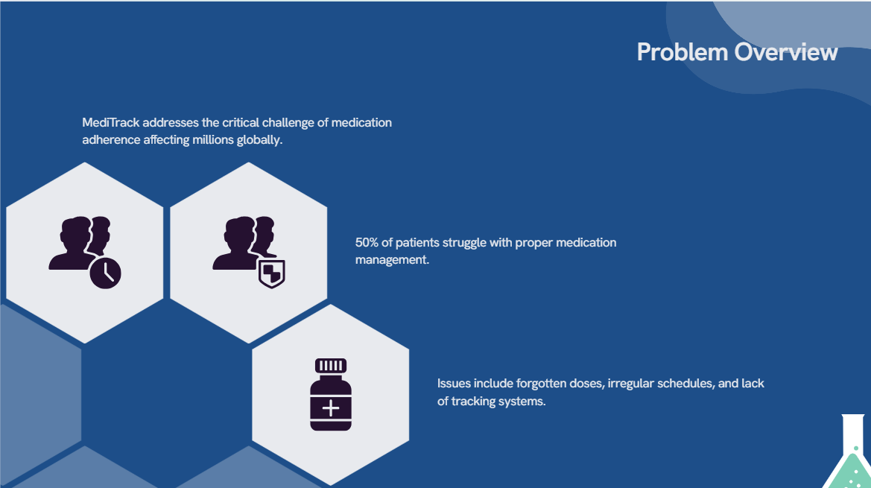

Slide 4


Slide 5


Slide 6
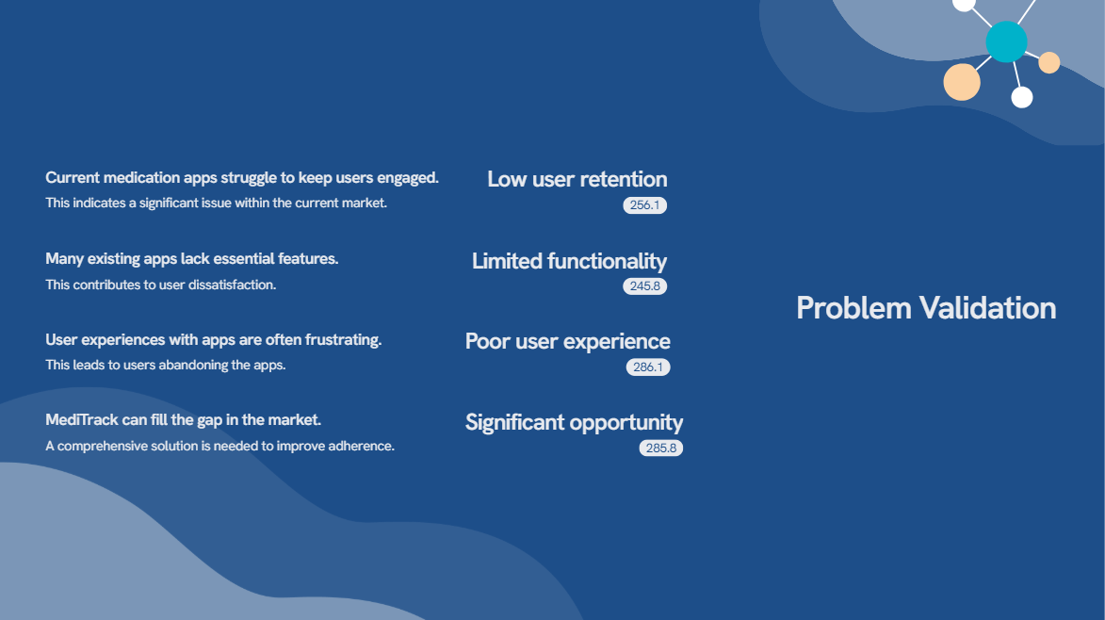

Slide 7
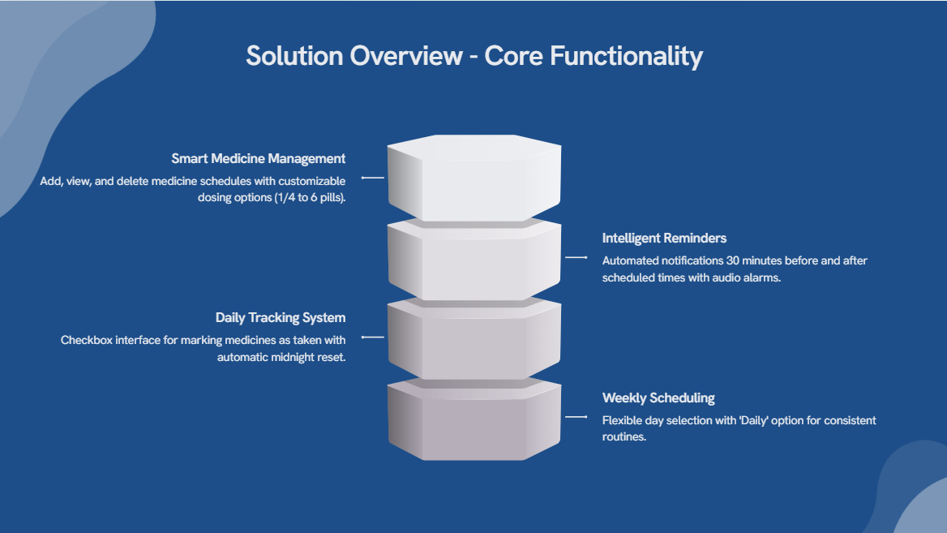

Slide 8
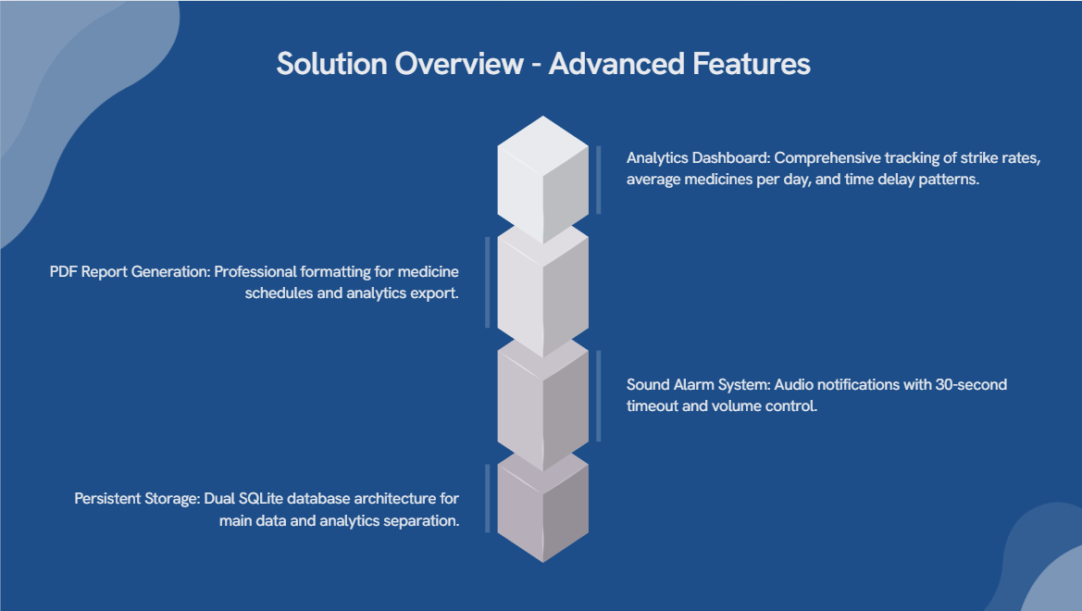

Slide 9
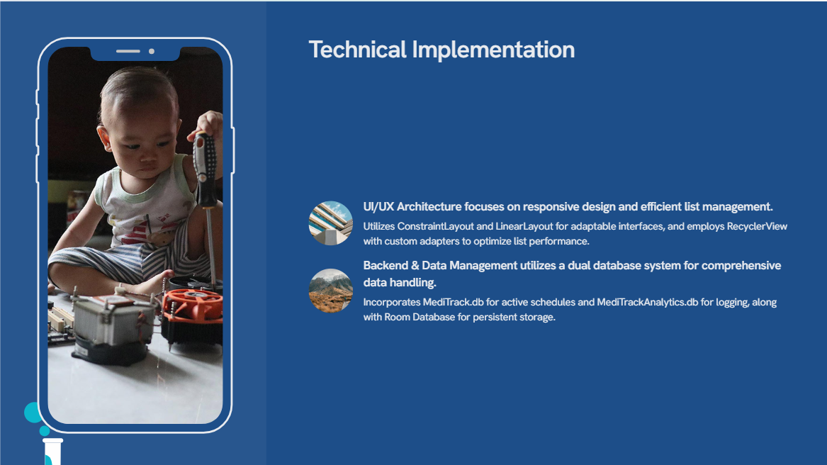

Slide 10
